Slide 1
Linked Lists

Slide 2
Anatomy of a linked list
A linked list consists of:
A sequence of nodes
myList
a
b
c
d
Each node contains a value
and a link (pointer or reference) to some other node
The last node contains a null link
The list may (or may not) have a header

Slide 3
More terminology
A node’s successor is the next node in the sequence
The last node has no successor
A node’s predecessor is the previous node in the sequence
The first node has no predecessor
A list’s length is the number of elements in it
A list may be empty (contain no elements)

Slide 4
Singly-linked lists
Here is a singly-linked list (SLL):
myList
a
b
c
d
Each node contains a value and a link to its successor (the last node has no successor)
The header points to the first node in the list (or contains the null link if the list is empty)

Slide 5
Creating a simple list
In C, we can implement a linked list using the following code:
struct node
{
int data;
struct node *next;
};
Note:
Linked lists provide an efficient way of storing related data and perform basic operations such as insertion, deletion, and updation of information at the cost of extra space required for storing address of the next node.

Slide 6
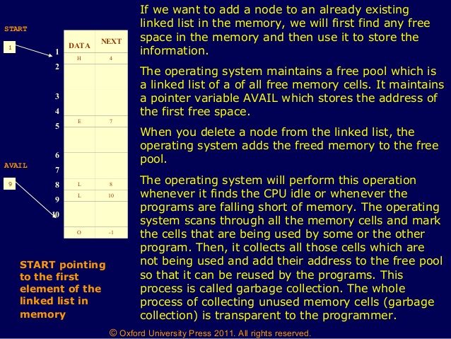
How a linked list is maintained in the memory

Slide 7
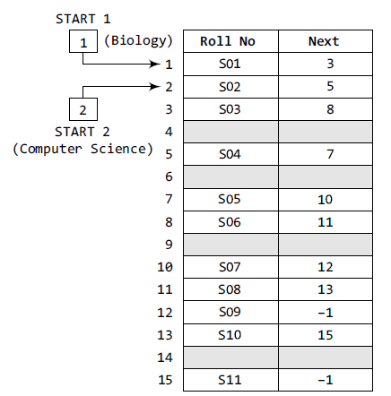


Slide 8
Array versus Linked Lists
Linked lists are more complex to code and manage than arrays, but they have some distinct advantages.
Dynamic: a linked list can easily grow and shrink in size.
We don’t need to know how many nodes will be in the list. They are created in memory as needed.
In contrast, the size of a C++ array is fixed at compilation time.
Easy and fast insertions and deletions
To insert or delete an element in an array, we need to copy to temporary variables to make room for new elements or close the gap caused by deleted elements.
With a linked list, no need to move other nodes. Only need to reset some pointers.

Slide 9
Array versus Linked Lists
Both arrays and linked lists are a linear collection of data elements. But unlike an array, a linked list does not store its nodes in consecutive memory locations.
Another point of difference between an array and a linked list is that a linked list does not allow random access of data.

Slide 10
Traversing a SLL
Step 1: [INITIALIZE] SET PTR = START
Step 2: Repeat Steps 3 and 4 while PTR != NULL
Step 3: Apply Process to PTR DATA
Step 4: SET PTR = PTR →NEXT
[END OF LOOP]
Step 5: EXIT

Slide 11
Algorithm to print the number of nodes in a
linked list
Step 1: [INITIALIZE] count =0
Step 2: [INITIALIZE] SET PTR = START
Step 3: Repeat Steps 4 and 5 while PTR != NULL
Step 4: count = count+1
Step 5: SET PTR = PTR→ NEXT
[END OF LOOP]
Step 6: Write count
Step 7: EXIT

Slide 12
Searching for a Value in a Linked List
Step 1: [INITIALIZE] SET PTR = START
Step 2: Repeat Step 3 while PTR != NULL
Step 3: IF VAL = PTR→ DATA
SET POS = PTR
Go To Step 5
ELSE
SET PTR = PTR→ NEXT
[END OF IF]
[END OF LOOP]
Step 4: SET POS = NULL
Step 5: EXIT

Slide 13
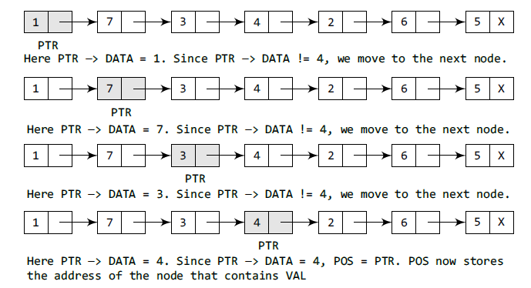
Searching an element example.
If we have VAL = 4, then the flow of the algorithm
can be explained as shown in the figure

Slide 14
Insertion in linked list
Case 1: The new node is inserted at the beginning.
Case 2: The new node is inserted at the end.
Case 3: The new node is inserted after a given node.
Case 4: The new node is inserted before a given node.

Slide 15
Inserting after (animation)
node
2.5
numerals
one
two
three
Find the node you want to insert after
First, copy the link from the node that's already in the list
Then, change the link in the node that's already in the list

Slide 16
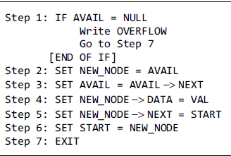
Insertion at begining

Slide 17
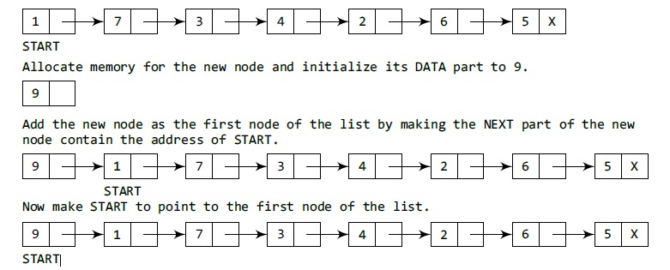
Insertion at begining

Slide 18
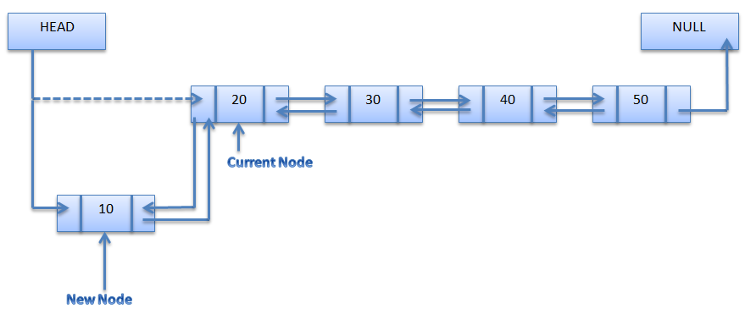

Slide 19
Insertion at end
Step 1: IF AVAIL = NULL
Write OVERFLOW
Go to Step 1
[END OF IF]
Step 2: SET NEW_NODE= AVAIL
Step 3: SET AVAIL = AVAIL->NEXT
Step 4: SET NEW_NODE->DATA = VAL
Step 5: SET NEW_NODE->NEXT = NULL
Step 6: SET PTR = START
Step 7: Repeat Step 8 while PTR-> NEXT != NULL
Step 8: SET PTR = PTR-> NEXT
[END OF LOOP]
Step 9: SET PTR ->NEXT =NEW_NODE
Step 10: EXIT

Slide 20
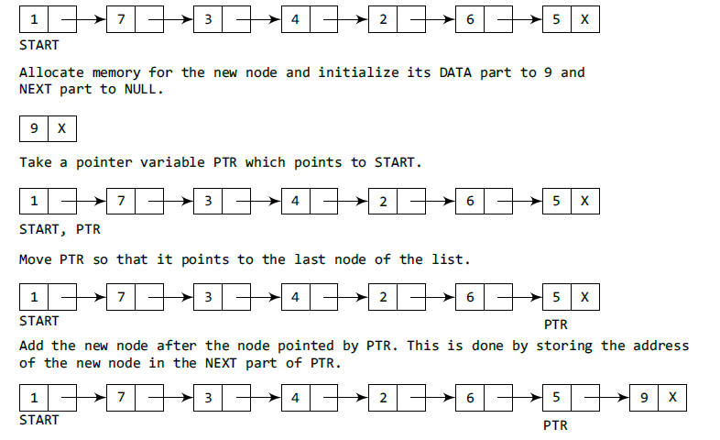
Insertion at end

Slide 21
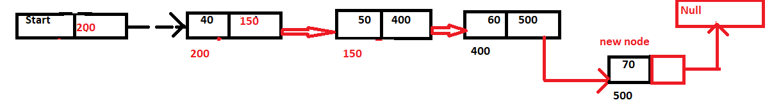

Slide 22
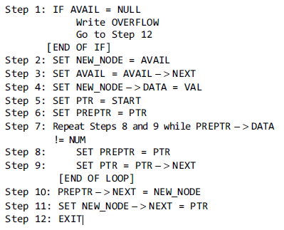
INSERTION After a given node

Slide 23
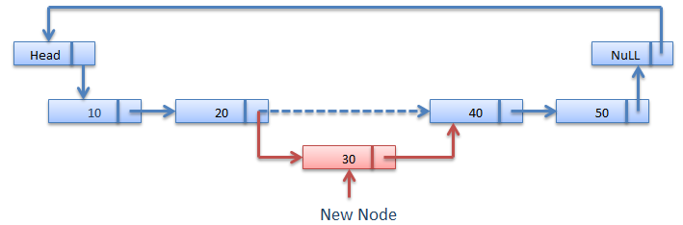

Slide 24
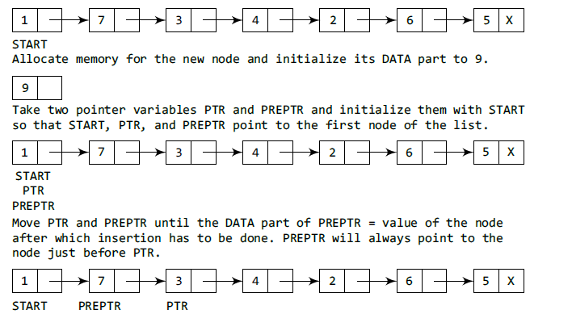

Slide 25
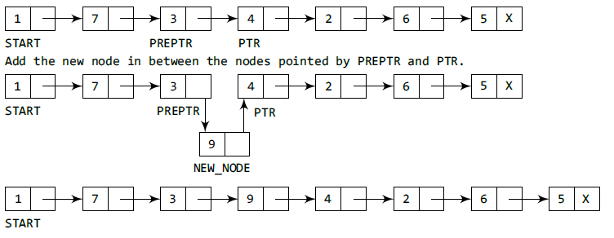

Slide 26
Deleting a node from a SLL
In order to delete a node from a SLL, you have to change the link in its predecessor
This is slightly tricky, because you can’t follow a pointer backwards
Deleting the first node in a list is a special case, because the node’s predecessor is the list header

Slide 27
Deleting an element from a SLL
• To delete the first element, change the link in the header
numerals
one
two
three
• To delete some other element, change the link in its predecessor
numerals
(predecessor)
one
two
three
• Deleted nodes will eventually be garbage collected

Slide 28
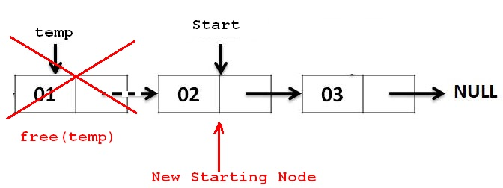
Algorithm to delete the first node
Step 1: IF START=NULL
Write UNDERFLOW
Go to Step 5 [END OF IF]
Step 2: SET PTR=START
Step 3: SET START=START → Link
Step 4: FREE PTR
Step 5: EXIT

Slide 29
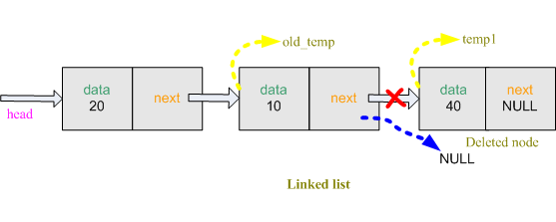
Delete the last node
Step 1: IF START=NULL
Write UNDERFLOW
Go to Step 8 [END OF IF]
Step 2: SET PTR=START
Step 3: Repeat Steps4and5while PTR → NEXT != NULL
Step 4: SET PTR1=PTR
Step 5: SET PTR=PTR → NEXT
[END OF LOOP]
Step 6: SET PTR1 → NEXT=NULL
Step 7: FREE PTR
Step 8: EXIT

Slide 30
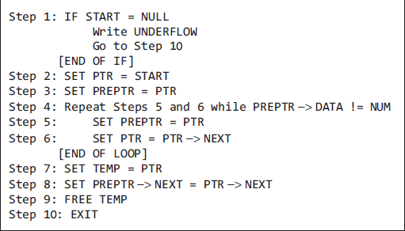
delete the node after a given node

Slide 31
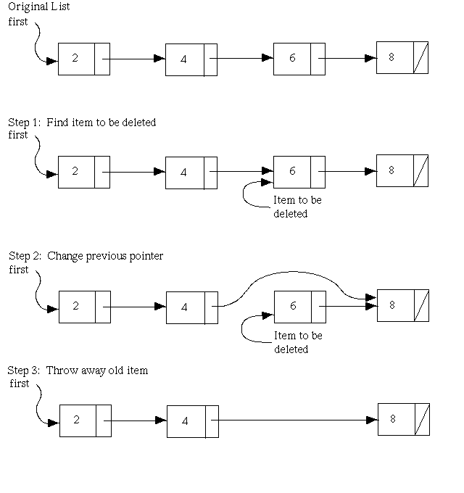
Delete the node after given node

Slide 32
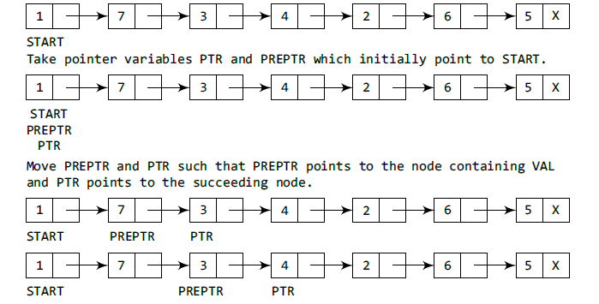

Slide 33
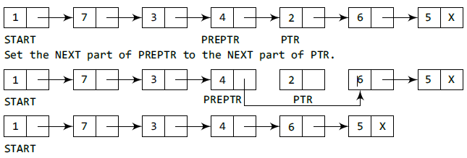

Slide 34
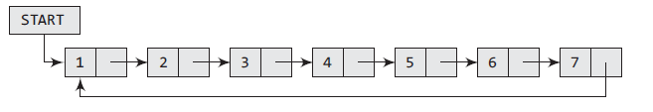
CIRCULAR LINKED LIST
In a circular linked list, the last node contains a pointer to the first node of the list. We can have a circular singly linked list as well as a circular doubly linked list. While traversing a circular
linked list, we can begin at any node and traverse the list in any direction, forward or backward, until we reach the same node where we started. Thus, a circular linked list has no beginning and no ending.

Slide 35
CIRCULAR LINKED LIST
An example where a circular linked list is used. When we are surfing the Internet, we can use the Back button and the Forward button to move to the previous pages that we have already visited. How is this done? The answer is simple. A circular linked list is used to maintain the sequence of the Web pages visited. Traversing this circular linked list either in forward or
backward direction helps to revisit the pages again using Back and Forward buttons. Actually, this is done using either the circular stack or the circular queue.

Slide 36
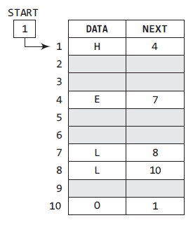
CIRCULAR LINKED LIST
Memory representation
of a circular linked list

Slide 37
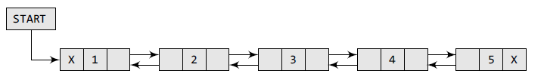
Doubly-linked lists
Here is a doubly-linked list (DLL):
Each node contains a value, a link to its successor (if any), and a link to its predecessor (if any)
The header points to the first node in the list and to the last node in the list (or contains null links if the list is empty)

Slide 38
Doubly-linked lists
In C, the structure of a doubly linked list can be given as,
struct node
{
struct node *prev;
int data;
struct node *next;
};
The PREV field of the first node and the NEXT field of the last node will contain NULL.

Slide 39
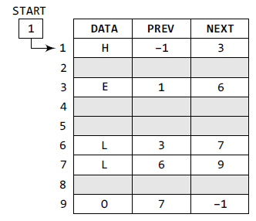
Memory representation of a
doubly linked list

Slide 40
APPLICATIONS OF LINKED LIST
Linked Lists can be used to implement Stacks , Queues.
Linked Lists can also be used to implement Graphs. (Adjacency list representation of Graph).
Implementing Hash Tables :- Each Bucket of the hash table can itself be a linked list. (Open chain hashing).
Undo functionality in Photoshop or Word . Linked list of states.
A polynomial can be represented in an array or in a linked list by simply storing the coefficient and exponent of each term.
However, for any polynomial operation , such as addition or multiplication of polynomials , linked list representation is more easier to deal with.
Linked lists are useful for dynamic memory allocation.
The real life application where the circular linked list is used is our Personal Computers, where multiple applications are running.
All the running applications are kept in a circular linked list and the OS gives a fixed time slot to all for running. The Operating System keeps on iterating over the linked list until all the applications are completed.

